Slide 1
Laravel
controllers
routes
views
PHP WebDevelopment 2021
Милена Томова
Vratsa Software
https://vratsasoftware.com/

Slide 2
Table of Contents
Controllers - Views - Routes
Php artisan
Plain controllers
Blade engine
Master.blade.php
@include
@extends
@section(‘section_name’)
@yield

Slide 3
Task
Task
List the pages of VSS Students` System
Setup the page structure
Develop the navigation

Slide 4
Intro

Slide 5
Intro
To access the application use the url -
localhost/path-to-your-project/public
The script in ...public/index.php is executed and the home page of the application is rendered in the browser.

Slide 6
Action flow
step 1
in app/routes/web.php -
an obligatory route declaration is defined
Route::get('/', function () {
return view('welcome');
});
that allows this view to be rendered when the ‘/’ end-point is accessed.

Slide 7
Action flow
step 2
in app/resources/views/welcome.blade.php -
a view file is created, holding the content to be displayed in the browser`s window.

Slide 8
Action flow - REMEMBER
return view('welcome');
is the
welcome.blade.php file, that resides in resources/view folder of the project

Slide 9
Blade engine

Slide 10
Blade engine
Blade is the simple, yet powerful templating engine provided with Laravel.
Unlike other popular PHP templating engines, Blade does not restrict you from using plain PHP code in your views.
All Blade views are compiled into plain PHP code and cached until they are modified.
Blade view files use the .blade.php file extension and are typically stored in the resources/views directory.

Slide 11
PHP Artisan

Slide 12
PHP Artisan
Artisan is the command-line interface included with Laravel. It provides a number of helpful commands that can assist you while you build your application.
To view a list of all available Artisan commands
php artisan list
Every command has a "help" screen with full info for command`s options and arguments
php artisan help command-name

Slide 13
Controllers

Slide 14
Controllers
Controllers group related request handling logic into a single class.
They are stored in the app/Http/Controllers directory.

Slide 15
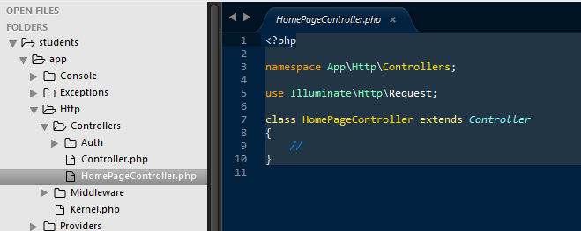
Controllers
To create a plain controller execute the command
рhp artisan make:controller HomePageController

Slide 16
Controllers
First task of the newly created HomePageController is to render the home page -
public function index() {
return view(‘home_page’);
}

Slide 17
Views

Slide 18
Views
In app/resources/views create
home_page.blade.php
This file will hold the content that will be displayed in the browser to the user who visits the Home page.

Slide 19
Routes

Slide 20
Routes
In routes/web.php we have to allow the rendering of home page to happen when accessing the ‘/’ end-point
use App\Http\Controllers\HomePageController;
//…..
Route::get('/', [HomePageController::class, 'index']);
With this declaration we allow the execution of the index method of the HomeController (HomePageController in the example above).

Slide 21
Routes
Named routes
Route::get('/',[HomePageController::class,'index'])->name('home');
Then we can easily create navigation links
<a href={{ route('home') }}> Home </a>
where
{{ route('home') }} is instead of <?php echo route('home') ?>

Slide 22
master.blade.php

Slide 23
master.blade.php
When there is repeated code in a number of views we can create a template file.
The repeated code is placed within this template file and
by using
@yield(‘section_name’)
we call the unique lines of code for every view that will extend tke template.
We can yield styles, js, html etc.

Slide 24
master.blade.php
The template files are usually named
master.blade.php
app.blade.php
admin.blade.php
etc
and are placed in a layouts folder /if there is more than one template/.

Slide 25
@extends(‘master’)
Every view.blade.php starts with the
@extends(‘template-name’) declaration,
if it is not an independent view, but extends a template.

Slide 26
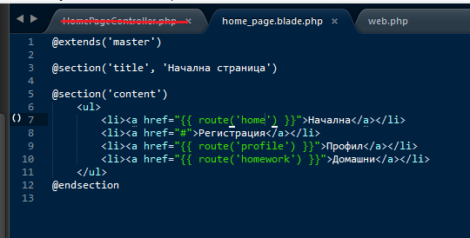
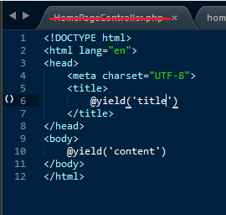
master.blade.php home_page.blade.php

Slide 27
Organise Blade files

Slide 28
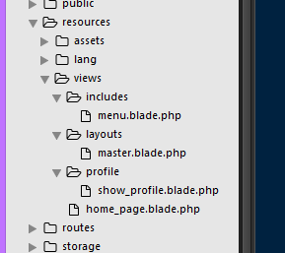
Organise Blade files
We can separate repeated pieces of codes in separate blade files.
Organise them in includes folders.
And include them where needed by
@extends(‘template-folder.template-name’)
@extends(‘layouts.master’)

Slide 29
Organise Blade files
It is very probable that your project will have or will expand to lots of view files.
It is a good practise to organise them in folders.
If a template is in a folder - it is referred by
@include(‘folder.filename’)
@includes(‘includes.menu’)

Slide 32



Trainings @ Vratsa Software
Vratsa Software – High-Quality Education, Profession and Jobs
www.vratsasoftware.com
The Nest Coworking
www.nest.bg
Vratsa Software @ Facebook
www.fb.com/VratsaSoftware
Slack Channel
www.vso.slack.com

